Slide 1
Research questions
Why do computer science students spend so much time on projects that are never used?
Why are new computer science grads so helpless when confronted with real projects?
What can we do to bridge this gap?

Slide 2
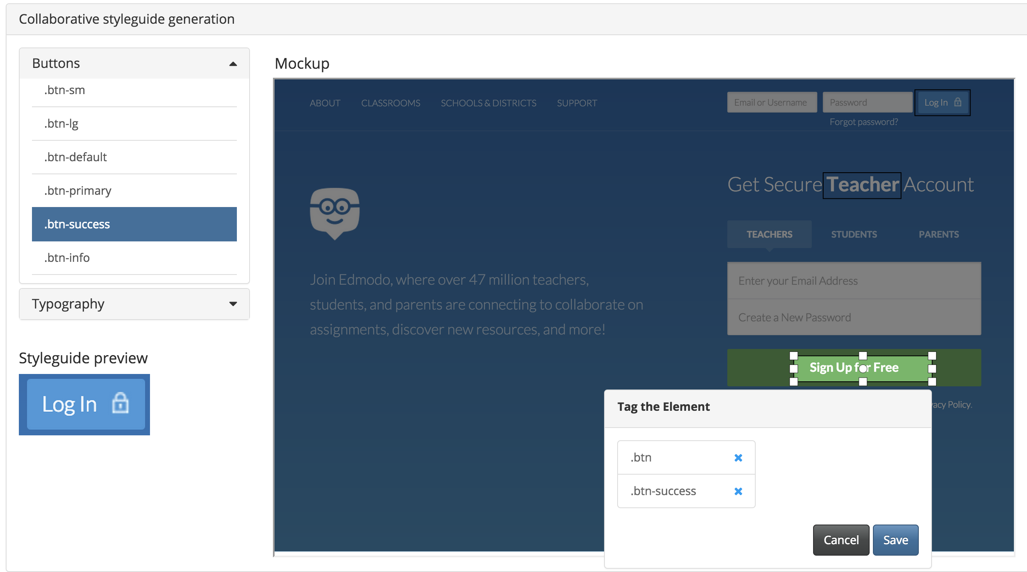
Programming with a Purpose
Idea: teach coding using real issues from open-source projects
Live editor interface
Scaffold to students’ skill level
Work on interesting and important pieces of code
Alex Hollenbeck, Phil House, Ben Rothman
Advisor: Prof. Haoqi Zhang

