Slide 1

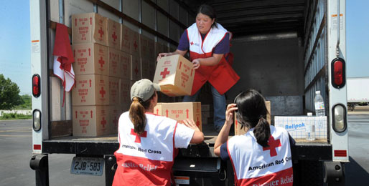
Volunteer Engagement in the Age of Analytics
A Case Study with
American Red Cross,
Greater Chicago Region
Andy Fox, Tessa Swanson, Karen Smilowitz – Northwestern IEMS
Jim McGowan – American Red Cross, Greater Chicago Region
November 9, 2014

Slide 2
Our Team
Karen Smilowitz: Professor of Industrial Engineering and Management Sciences, leads Northwestern Initiative on Humanitarian Logistics
Andy Fox: Graduate student, Master of Science in Analytics
Tessa Swanson: Undergraduate student, Industrial Engineering and Management Sciences & Volunteer Dispatcher at American Red Cross, Greater Chicago Region
Jim McGowan: Regional Planner, Readiness and Situational Awareness Program Manager at American Red Cross, Greater Chicago Region

Slide 3


Slide 4
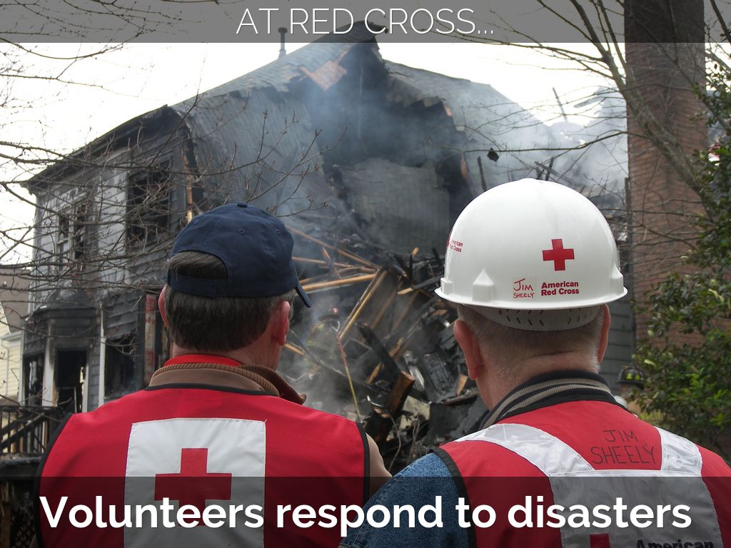

Slide 5


Slide 6
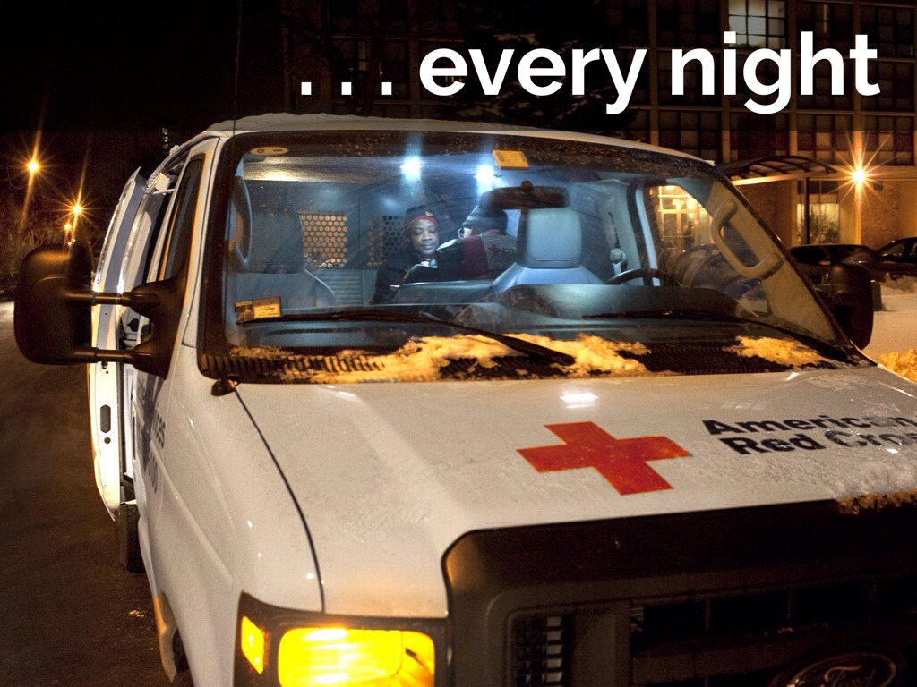

Slide 7
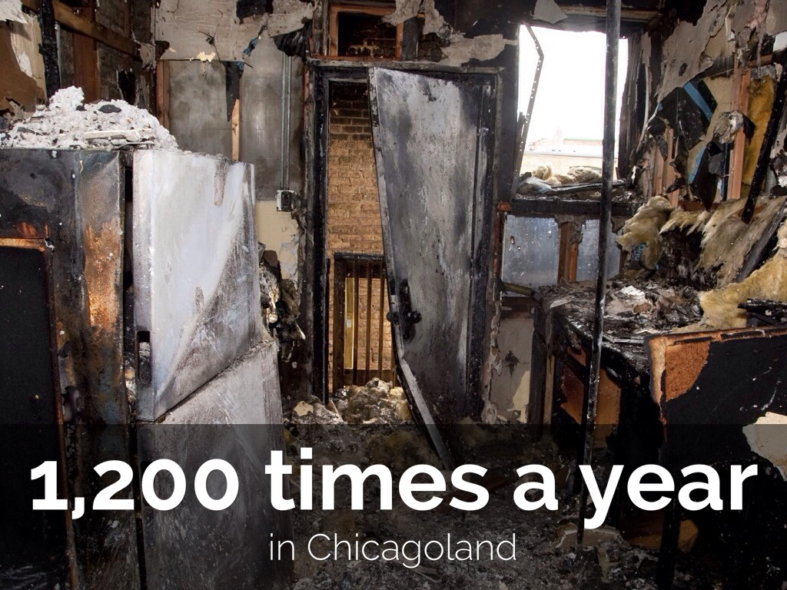

Slide 8
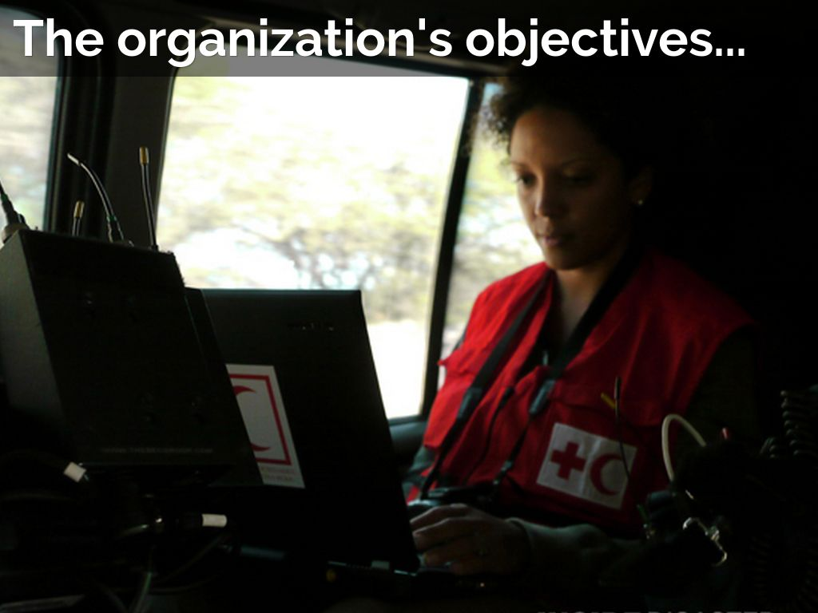

Slide 9


Slide 10


Slide 11
What it means to respond
Receive call from a dispatcher
Ideally one “Full Responder” and one “Trainee” on team
Travel from home or Red Cross HQ to disaster site
Communicate with first responders to assess damage
Communicate with victims to determine need
Fill out paperwork
Provide assistance to victims
  3-day debit card for food, clothing, shelter
  Contact with Health or Mental Health services if necessary
Communicate with dispatcher throughout

Slide 12
Presentation overview
Research motivation
American Red Cross, Greater Chicago Region (ARCGCR) disaster response overview
Results
  Descriptive analytics
  Dynamic scheduling
  Dispatch protocols
Implementation

Slide 13
Research Motivation
Contribution to ARCGCR
Utilize multiple data sources to model the two objectives: volunteer engagement and response effectiveness
Develop recommendations for ARCGCR to recruit, retain and dispatch volunteers
Contribution to Research
Volunteer engagement rarely studied quantitatively
Volunteer scheduling focused on singular events, not ongoing need
Emerging use of statistical and visualization techniques in broader applications
Volunteer Engagement in the Age of Analytics

Slide 14
ARCGCR Volunteer Development Process
Training and Onboarding
Scheduling
Response
1
2
3

Slide 15
Training and Onboarding
Key checkpoints
  Referral
  New volunteer orientation
  Two disaster action team training courses
  Assigned to ARCGCR staff member
Data stored in Volunteer Connection
Process often takes several months, requires multiple trips to ARCGCR HQ
Large step between training and onboarding & “engagement”

Slide 16
Scheduling
ARCGCR aims to have volunteers on-call at all times
Six shifts a day
Volunteers sign up for shifts up to three months in advance
Encouraged to sign up for at least 4 shifts
“Flex schedule”
Estimated 0-5 scheduled responders, 10 flex responders at any given time
Schedule is not obligatory

Slide 17
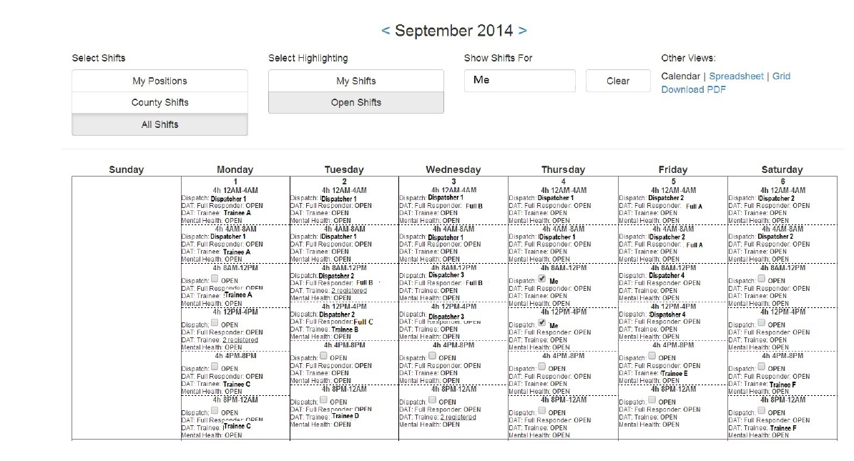

Slide 18
Response
Dispatcher alerted of incident via e-mail or phone call
“Callout” to identify one Full Responder and one Trainee
90 minute time constraint
Assign Americorps if necessary

Slide 19
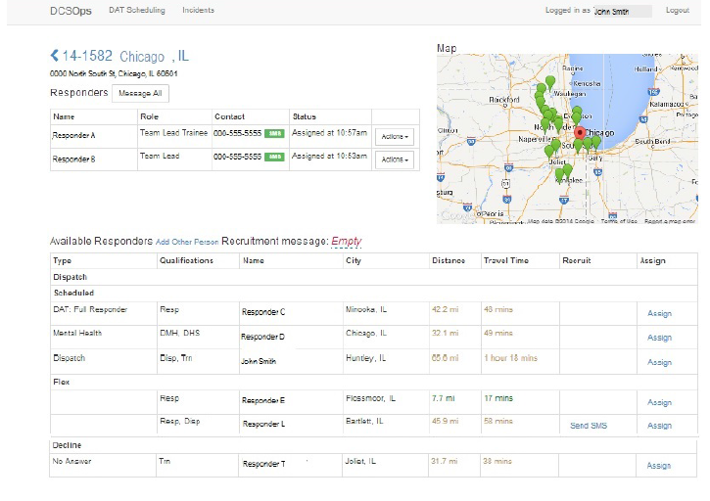

Slide 20
Research Goals Within the Volunteer Process
Training and Onboarding
Scheduling
Response
1
2
3
Establish data connection points and key performance indicators
Create a balanced schedule of volunteers tied to expected disaster occurrence
Predict likelihood a volunteer will respond to a dispatch and use this insight to ensure proper coverage

Slide 21
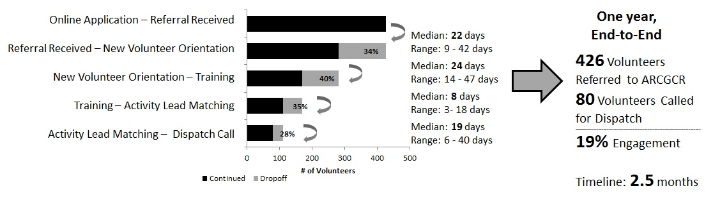
Integrating Data Streams Reveals Inefficiencies
1
Initial engagement
  The journey of a volunteer from prospect to disaster responder
  19% of prospects remain engaged through this stage
Sustained engagement
  The responses of a volunteer when provided the opportunity to respond to a disaster
  12% of volunteers receive 70% of the opportunities to participate

Slide 22
What Factors of Incidents Impact Scheduling?
2
4 hypotheses of factors leading to volunteer response
Explanatory predictive models test these hypotheses
 | Hypothesis | Implication
1 – Schedule | Presence on the schedule increases a responder’s acceptance of dispatch | Motivates the need for a balanced schedule
2 – Temporal | Response rates vary based on temporal attributes of the incident, e.g. time of day | A balanced schedule does not necessarily mean the same # of volunteers per shift
3 – Experience | Volunteer level of experience impacts a responder’s acceptance of dispatch | A balanced schedule does not necessarily mean the same # of Trainees as Full Responders
4 – Distance | Responders have a “radius of comfort” indicated by varying response rates over distance | Dispatchers may need to consider such criteria when calling volunteers

Slide 23
ARCGCR Collects Rich Volunteer Response Data
2
Granularity
  A call by a dispatcher to a responder to serve a particular incident
Response variable
  1 if the responder accepts a dispatch, 0 otherwise
Predictor variables of the responder and the incident
  On-schedule: volunteer is self-scheduled for the shift (binary)
  Role/experience: Trainee, Full Responder, or Other (categorical)
  Distance: distance from volunteer home to incident site (numeric)
  Time of day: morning, afternoon, evening, late night (categorical)
  Day of week: weekend vs. weekday (binary)
  Location: downtown Chicago vs. suburban Chicagoland (binary)
  Income: median of income for the incident’s zip code
  Population: population for the incident’s zip code

Slide 24
Hypothesis Testing Via Three Predictive Models
2
Stepwise Logistic Regression
Logistic Regression with Interactions
Boosted Tree
Variable | Coeff. | p-Value
(Intercept) | 0.56 | .0027
On-schedule | 1.02 | <.0001
Trainee | -1.20 | <.0001
Full Responder | -0.35 | .011
Afternoon | 0.19 | .0045
Weekend | -0.36 | <.0001
Downtown | 0.14 | .041
Distance | -0.0076 | .054
Income | -0.0052 | .0039
Variable | Coeff. | p-Value
(Intercept) | 0.22 | .32
On-schedule | 0.83 | <.0001
Trainee | -1.14 | <.0001
Full Responder | 0.13 | .46
Late Night | 0.56 | .0013
Afternoon | 0.15 | .073
Evening | 0.12 | .42
Weekend | -0.36 | <.0001
Downtown | 0.19 | .0079
Distance | 0.017 | .016
Income | -0.0045 | .013
Late Night*Distance | -0.047 | <.0001
Evening*Distance | -0.016 | .11
Schedule*Distance | 0.016 | .071
Full Responder*Distance | -0.034 | <.0001
Variable | Influence
Distance | Highest
On-Schedule | High
Trainee | High
Income | Moderate
Population | Moderate
Weekend | Moderate
Evening | Low
Downtown | Low
Afternoon | Low
Late Night | Low
Full Responder | Lowest
CV Misclassification Rate: 37.0%
CV Misclassification Rate:
30.3%
CV Misclassification Rate: 36.5%

Slide 25
Volunteer and Incident Factors Inform Scheduling
2
Hypothesis 1: Schedule – Fully supported
  Volunteer on schedule up to 3 times more likely to respond
  Second highest influence in the boosted tree
Hypothesis 2: Temporal – Supported for some attributes
  Afternoon incidents have higher response rates
  Weekends decrease response outcome by 30%
Hypothesis 3: Experience – Supported at the Trainee level
  Trainees are 40-80% less likely to respond than Full Responders and specialists
  Third highest influence in the boosted tree
Hypothesis 4: Distance – Some indication of “radius of comfort”
  Additional mile of travel reduces response likelihood by less than 1% overall
  Additional mile of travel reduces response likelihood by 2-5% at certain times of day
  Highest influence in the boosted tree

Slide 26
Volunteer Reputation Provides the Missing Piece
3
Dispatcher survey administered as a complement to empirical testing
  Wide range of calls required to staff an incident (3 to 15)
  High variability in perception of “radius of comfort”
  Unrealized information need: volunteer reliability
Conjecture: a volunteer’s past reliability impacts future response
  Introduce the reputation function as a prior probability
  Strengthen predictive model with Bayesian inference
Benefits
  Volunteer response misclassification rate improves by 4-8%
  Shows actionable intervention points for each volunteer

Slide 27
Research Leads to Implementation at ARCGCR
Process Segment | Proposed Change | Implementation | Ease
Onboarding | Encourage dispatchers to call new volunteers first | Modify Call Out interface | Simple
 | Focus recruiting efforts in communities with strong response rates | Deploy interactive data visualization | Moderate
Scheduling | Utilize a data-driven scheduling system | Enhance DCSOps with algorithms | Difficult
Response | Identify volunteers requiring intervention | Build reputation curves | Simple
 | Match dispatches with volunteer engagement needs | Supply model interpretation to Dispatchers | Moderate
Key Implementation Result: Technology-Enabled Engagement

Slide 28
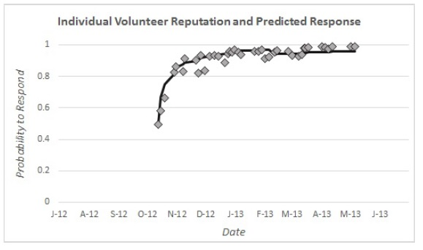
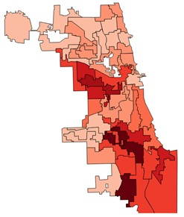
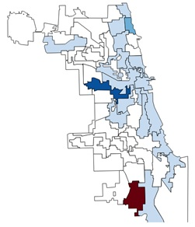
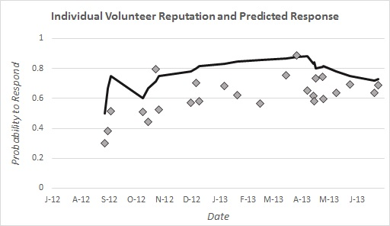
Data Visualization Examples
Volunteer intervention
Response rate trending
Community outreach and recruiting

Slide 29
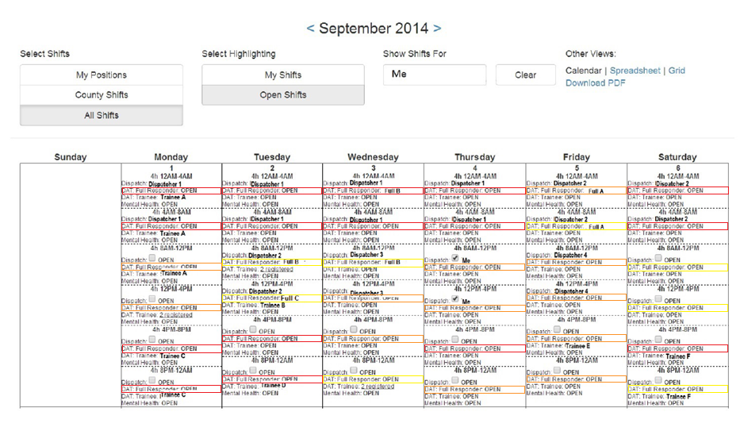
Dynamic Schedule - Full Responder from downtown

Slide 30
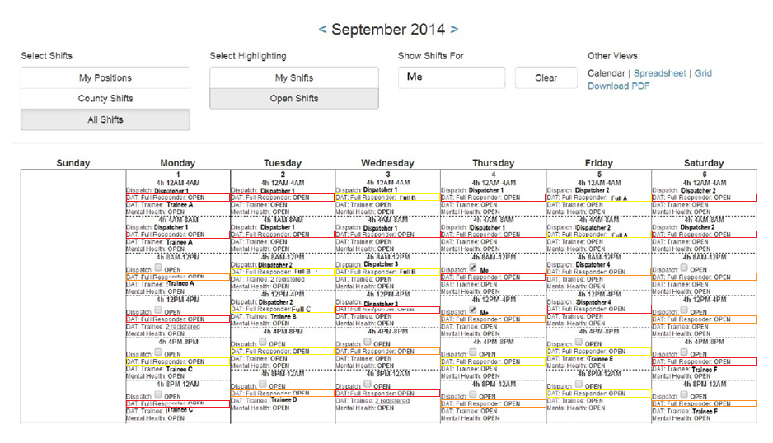
Dynamic Schedule - Full Responder from west suburb

Slide 31
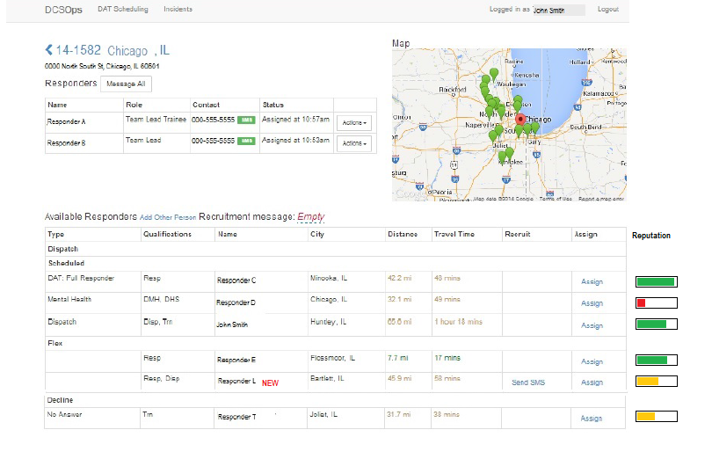
Callout Improvements

Slide 32
Questions?
More information about
Humanitarian Logistics at Northwestern at:
http://hl.mccormick.northwestern.edu/

