Slide 1
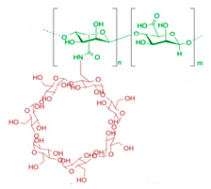
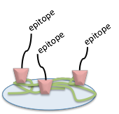



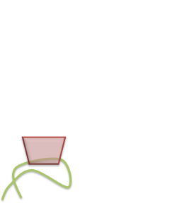
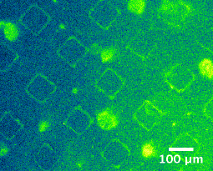
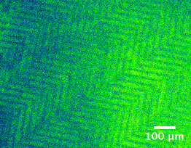
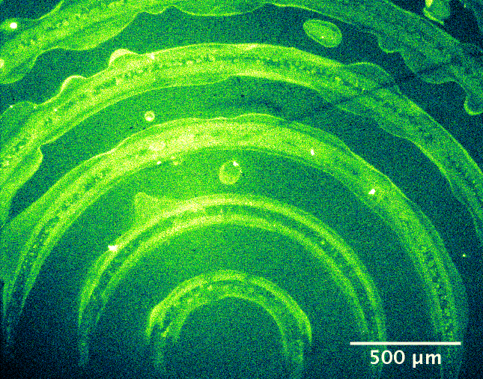
Dynamic Display of Bioactivity for Regenerative Medicine
Challenge:
Regenerative medicine by stem cells is potential solution for tissue repair
However, regeneration is complex - cellular responses change over:
  Time attachment → proliferation → differentiation
  Space bone, nerve, skin differentiation within one tissue
Develop ECM with dynamic spatio-temporal control over epitope display
Dynamic alginate-cyclodextrin surface with dynamic host-guest chemistry:
Allows for dynamic spatio-temporal manipulation of cell activities
Time stepwise exchange of biochemical cues (epitopes) can direct
cell activity
Space surface patterns direct cell growth
Surface is functionalizable
Surface can be patterned
Ellen Zhuang | The Stupp Group

