Slide 1
Medill and McCormick
San Francisco
Space
44 Montgomery, 18th Floor
Information as of September, 2016

Slide 2
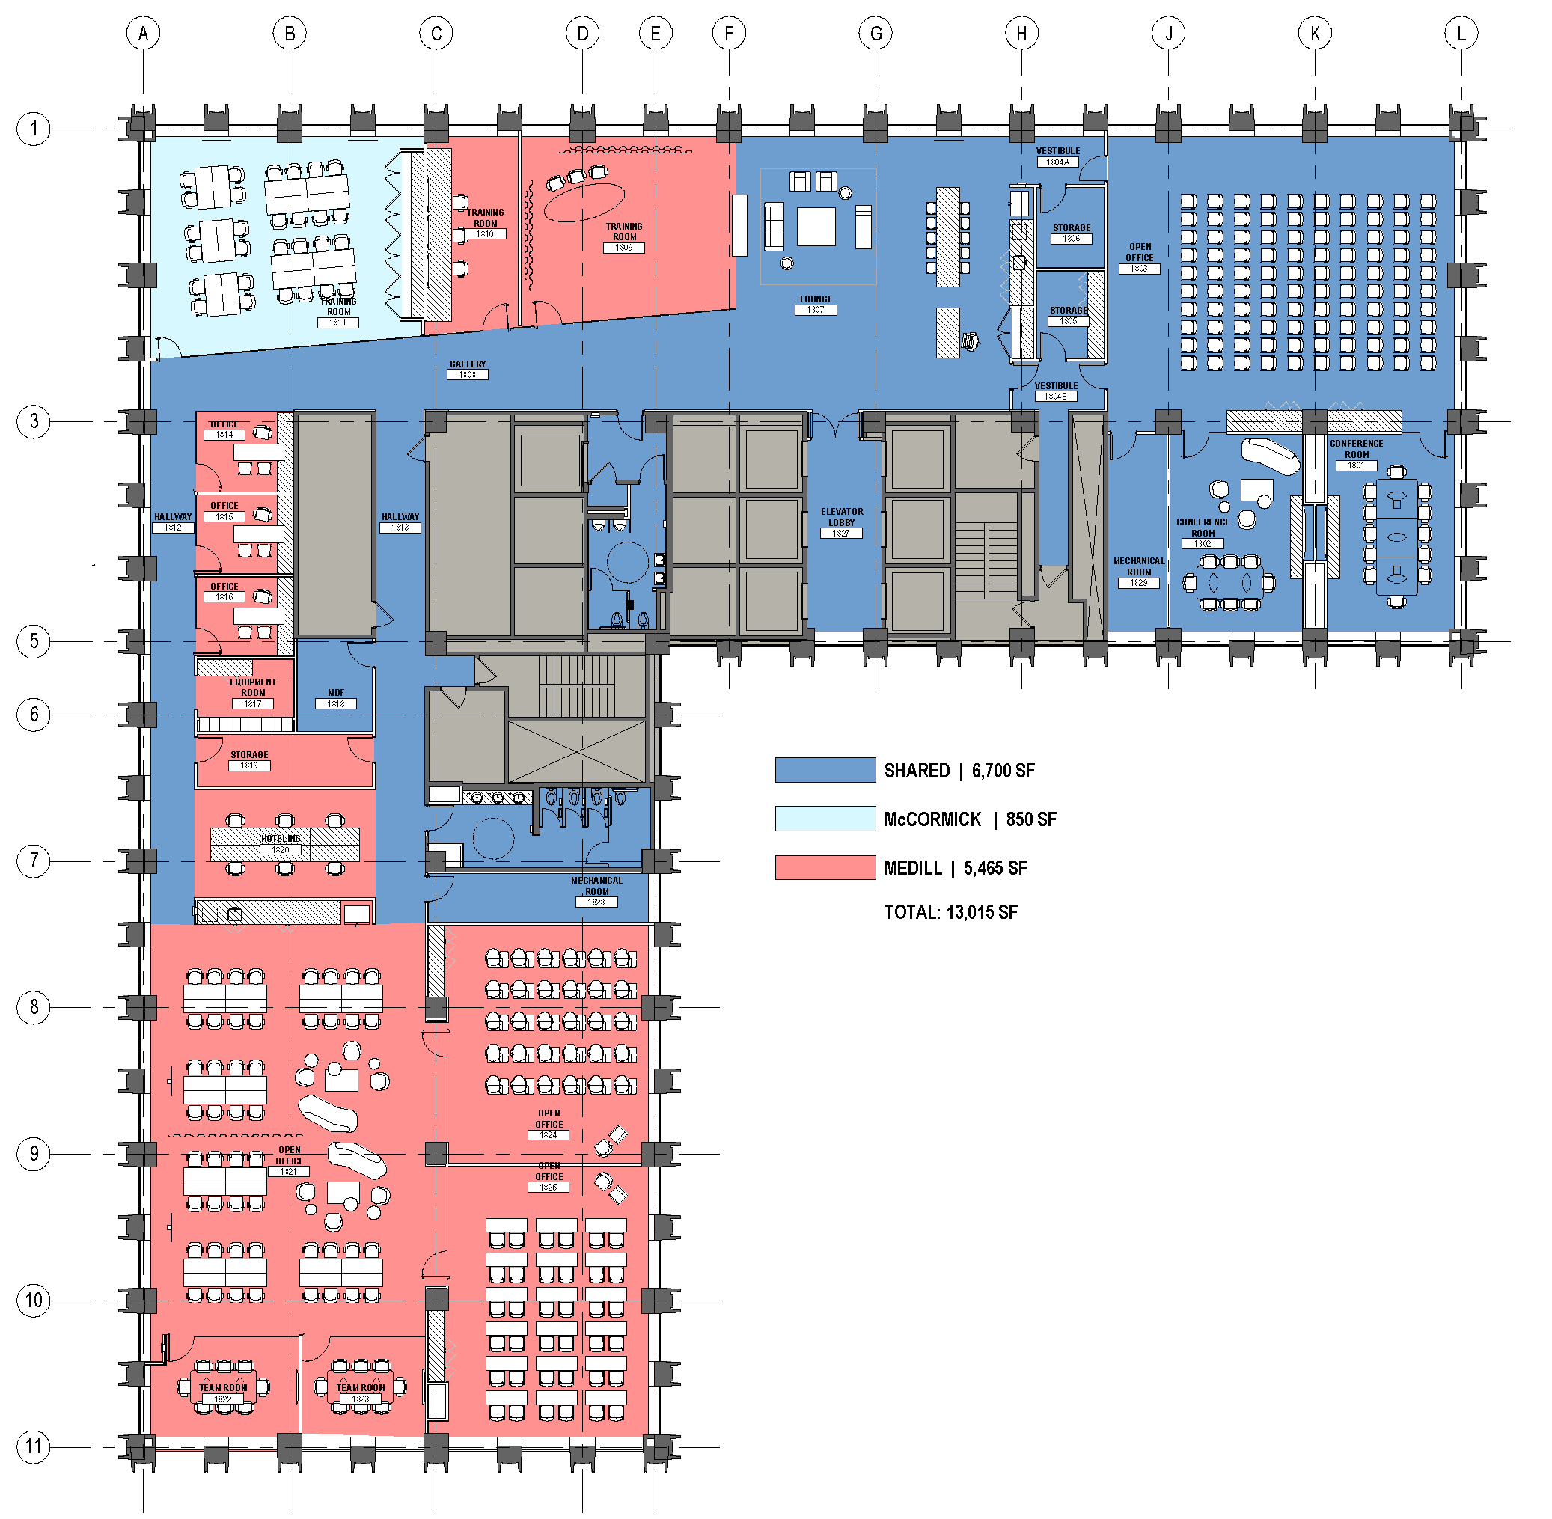
18th Floor Plan

Slide 3
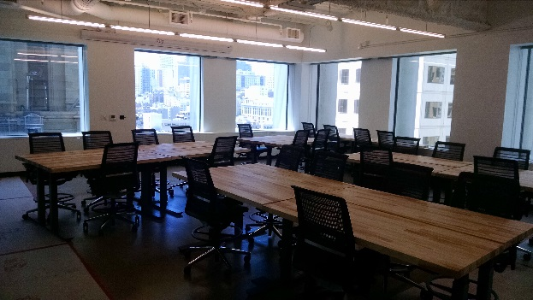
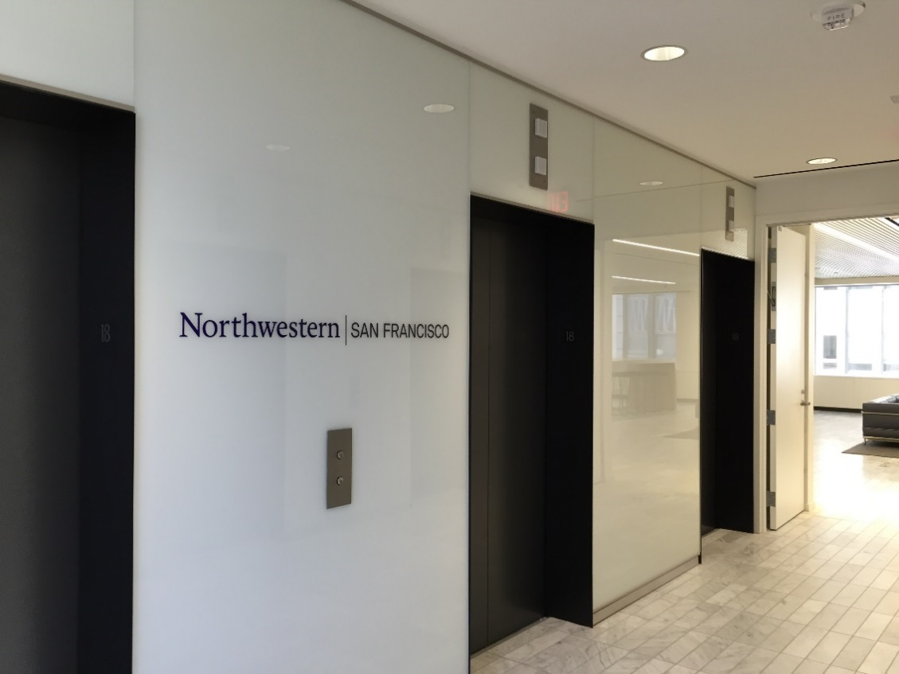
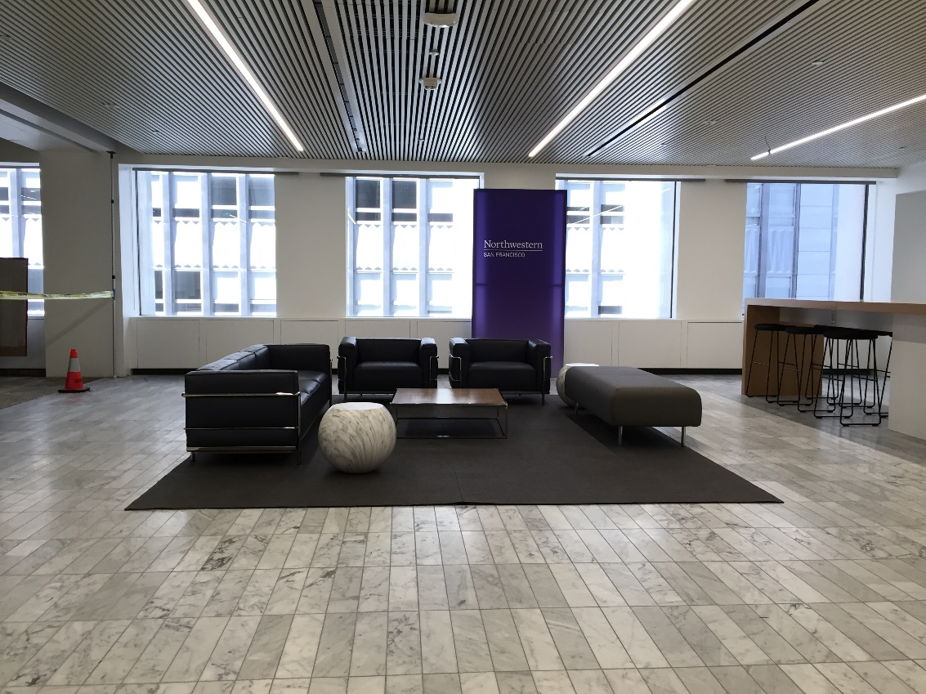
Interior Photos
McCormick Room 1811
Elevator Lobby
Shared Lounge Space 1807

Slide 4
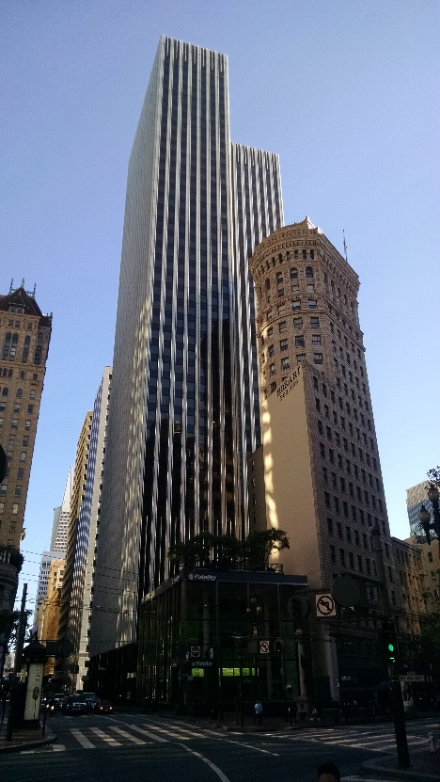
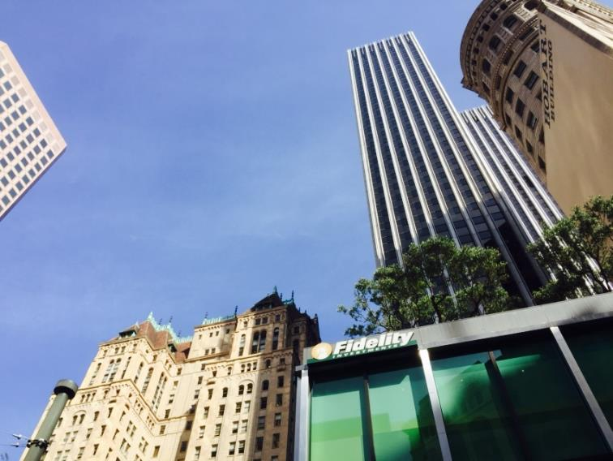
Exterior Photos

Slide 5

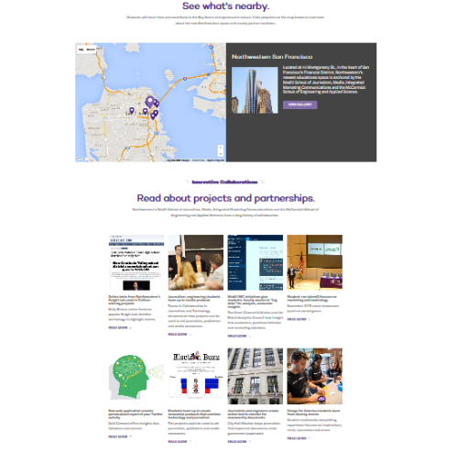
Webpage Link:
http://www.northwestern.edu/san-francisco/

